Slide 1

Batch No. 23
Department of ECE
Heart Disease Prediction using Ai/ML
Mohammed Abdul Musharaf ECE-B, 160718735066
Syed Abdul Quddoos , ECE-B, 160718735069
Aqib Ali Khan , ECE-B, 160718735093
Under the Guidance of
Mr. Ramesh Malaya,
ECE Department

Slide 2
Engineering Subjects covered in this project 1. Artificial Intelligence 2. Machine learning
Heart Disease Prediction using Ai/ML
Department of ECE

Slide 3
Project Work 1 Details Using CSV files to execute them in the python coding language under anaconda navigator. These were the instructions given to us by the PRC for the extension of the Project work - II
Heart Disease Prediction using Ai/ML
Department of ECE

Slide 4
Abstract
Heart Disease Prediction using Ai/ML
With the increasing population and illness, it's become a challenge to diagnosis illness and providing the suitable treatment at the proper time.
To develop an application which can predict the vulnerability of a heart disease given basic symptoms like age, sex, pulse rate etc
At analysing the assorted datamining techniques particularly Naive Bayes, Random Forest Classification, Support Vector Machine by employing a qualified dataset for cardiopathy prediction.
Department of ECE

Slide 5
Literature Survey The main objective of this study is to predict weather a patient is affected with cardiopathy or not exploitation totally different machine learning algorithms on a certified dataset. conclude the correlations between totally different attributes. getting clear plan of our projected data processing techniques and analyze the result and scrutiny between the results of various data processing techniques. we are going to analyze our techniques if there's any chance to bring improvement for our results.
Heart Disease Prediction using Ai/ML
Department of ECE

Slide 6
Heart Disease Prediction using Ai/ML
In our project, proposed system is accuracy prediction of heart disease problem in health care application. Easier to analyse the scalable of health care big data. Less time consumption with efficiency of data in heart disease. High performance in data maintained of heart disease prediction.
Remote mobile health monitoring has already been recognized as not only a potential. Each stage such as data aggregation, data maintenance, data integration, and data analysis, and pattern interpretation, application faces many challenges while dealing with healthcare big data (HBD).
There are many problems in complexity of analysis and scalable of data in parallelization computing model is processed. They have not accuracy in prediction of heart disease.
Department of ECE

Slide 7
Heart Disease Prediction using Ai/ML
EDA (EXPLORATORY DATA ANALYSIS) - In this section we are going to count values of explained variable otherwise known as the determining variable which is going to give us the prediction of a patient being affected by heart disease or not. Second of all we are going to separate numeric features from categorical features. Then we are going to show the relation between the categorical features in various plots and try to figure out or rather observe the influence of those categorical features in the actual determining variable “diagnosis”.
Splitting and Classification: The whole database is split into training and testing database. The 80% data is taken for training while remaining 20% data is used for testing.
Formatting: The data you have selected may not be in a format that is suitable for you to work with. The data may be in a relational database and you would like it in a flat file, or the data may be in a proprietary file format and you would like it in a relational database or a text file.
Cleaning: Cleaning data is the removal or fixing of missing data. There may be data instances that are incomplete and do not carry the data you believe you need to address the problem. These instances may need to be removed.
Department of ECE

Slide 8
Heart Disease Prediction using Ai/ML
Planning of the extension of this project took us around a week.
Research work of collecting data took us one and a half weeks.
Execution of the code (with debugging) challenged us for two weeks.
Report and thesis cumulatively took us about five days.
So in total we dedicated a whole month and a half over this project.
Department of ECE

Slide 9
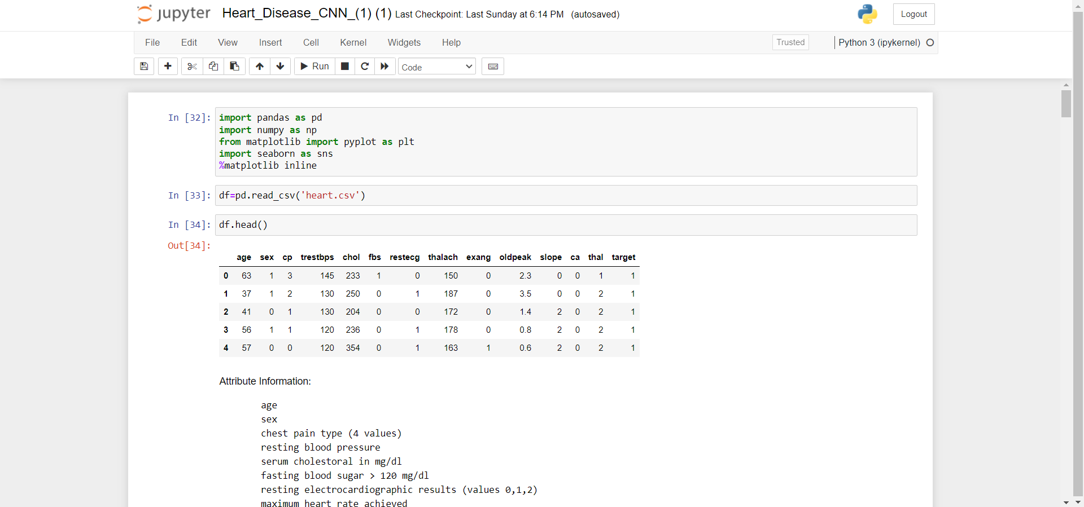
Heart Disease Prediction using Ai/ML
Procedure/Working

Slide 10
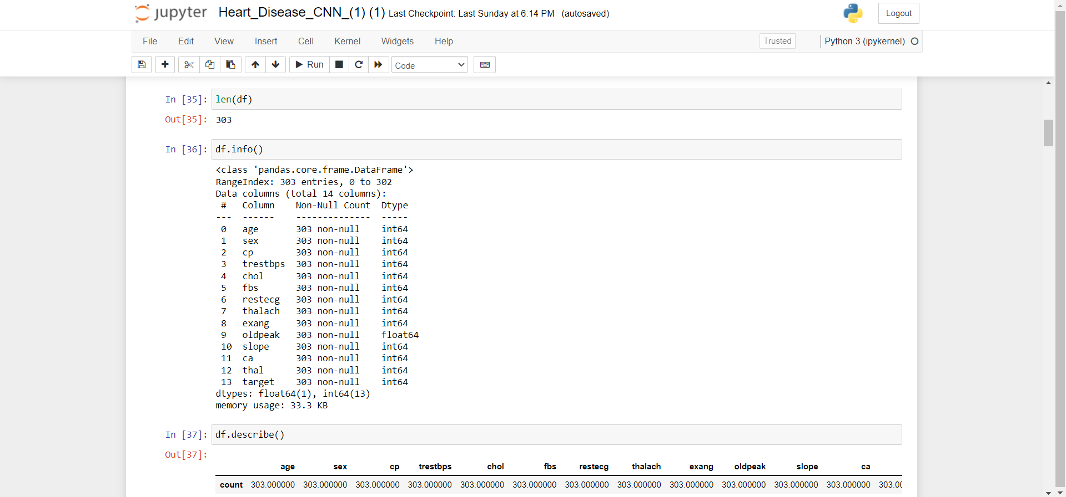
Heart Disease Prediction using Ai/ML

Slide 11
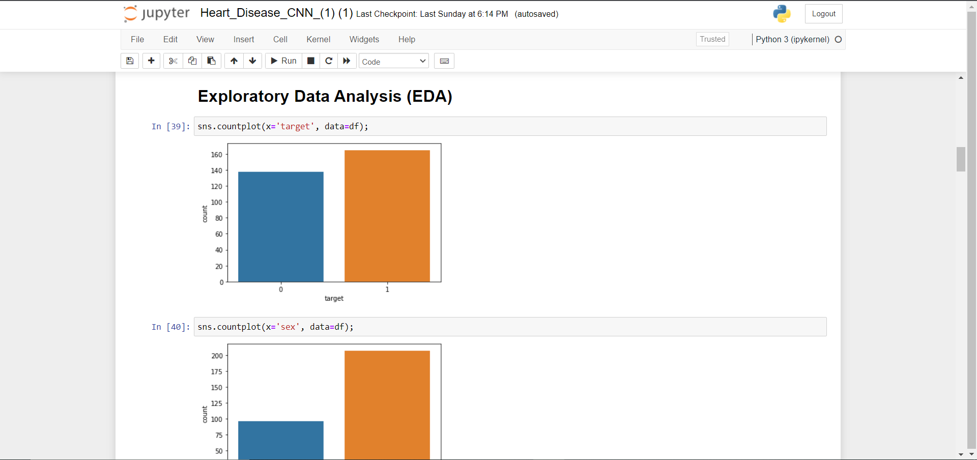
Heart Disease Prediction using Ai/ML

Slide 12
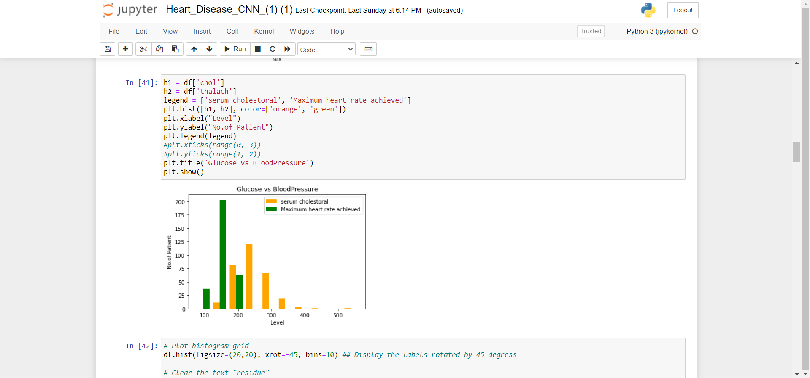
Heart Disease Prediction using Ai/ML

Slide 13
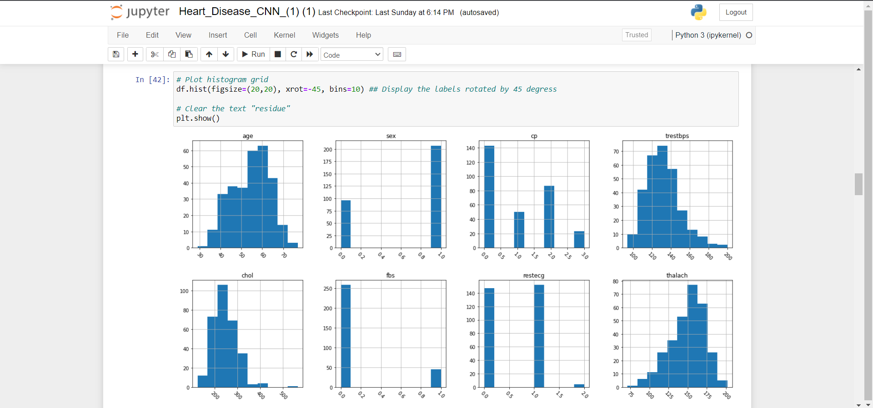
Heart Disease Prediction using Ai/ML

Slide 14
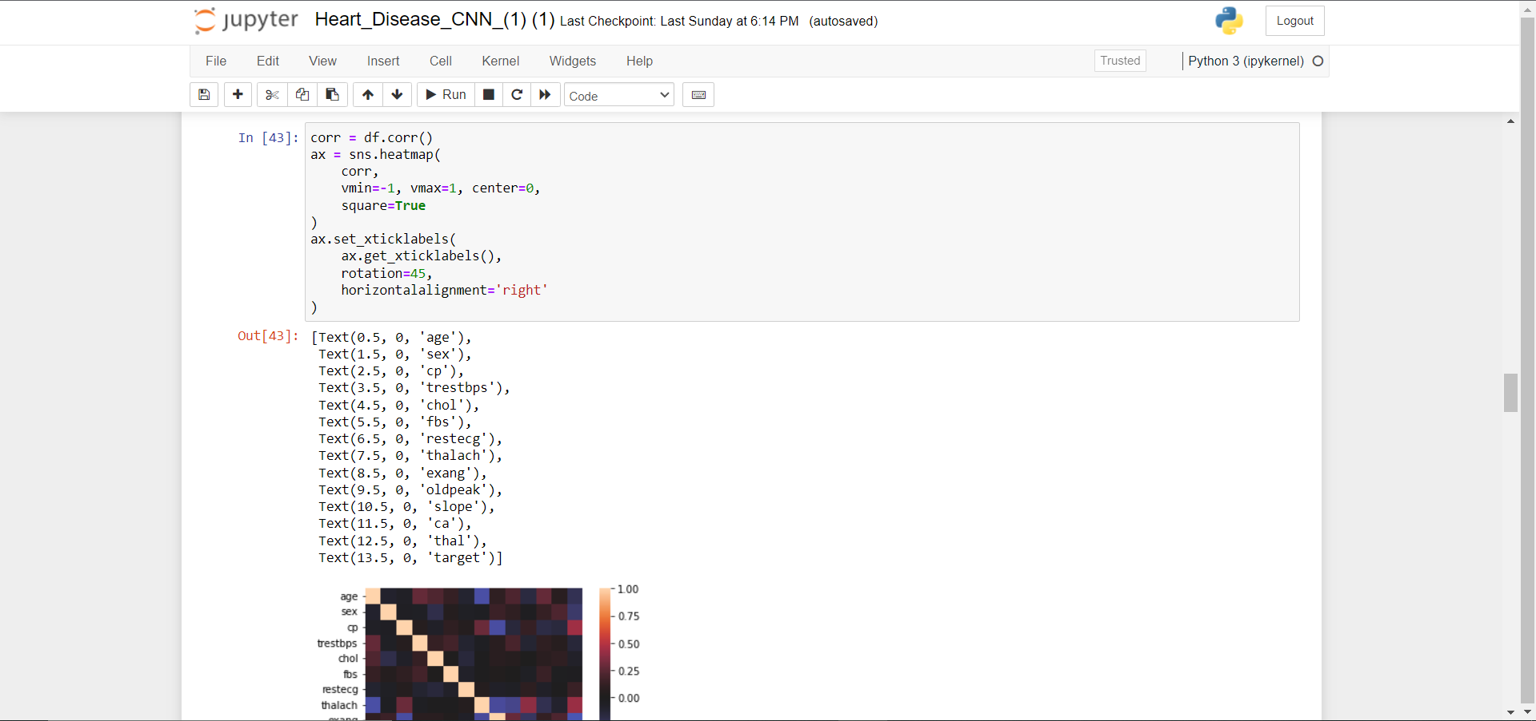
Heart Disease Prediction using Ai/ML

Slide 15
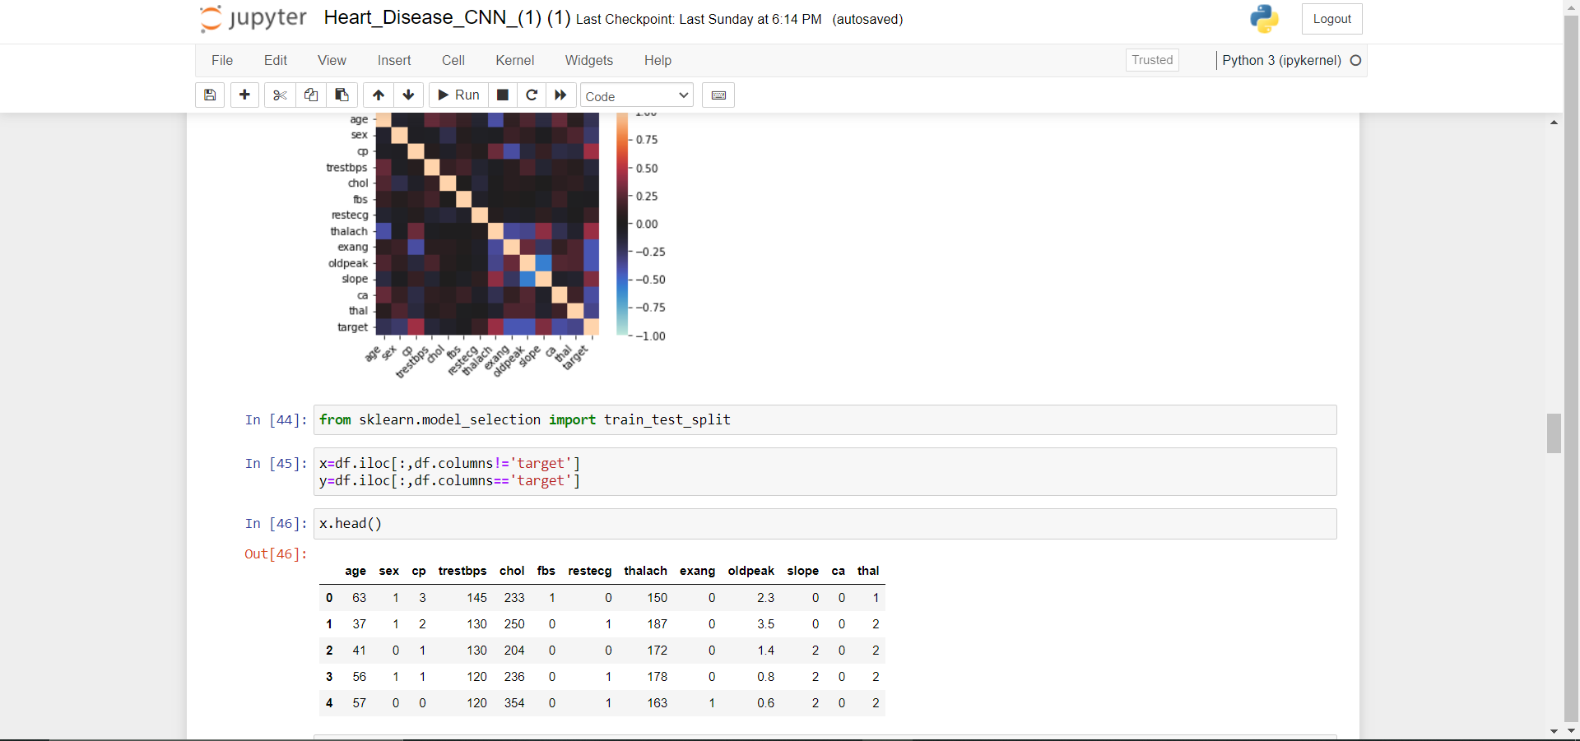
Heart Disease Prediction using Ai/ML

Slide 16
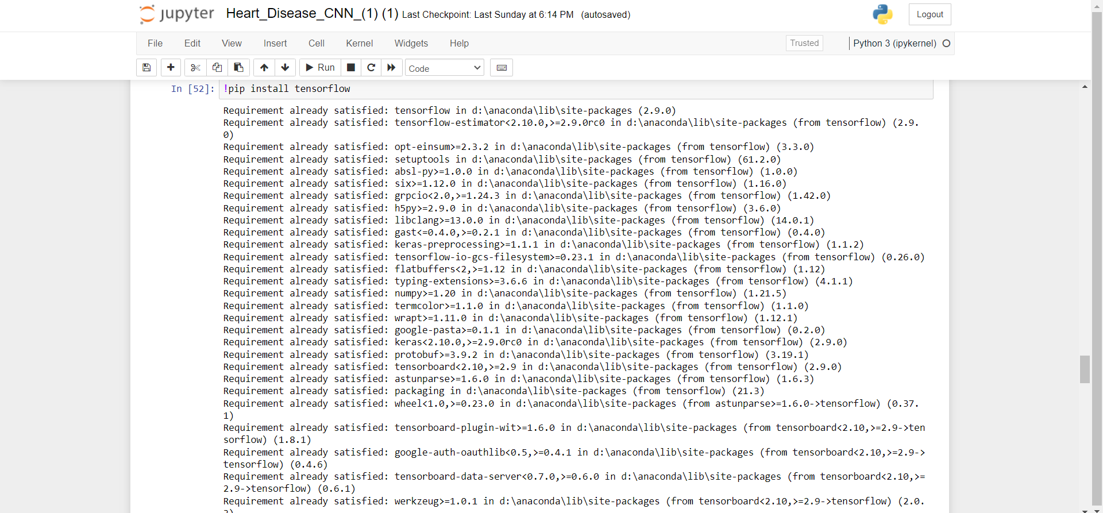
Heart Disease Prediction using Ai/ML

Slide 17
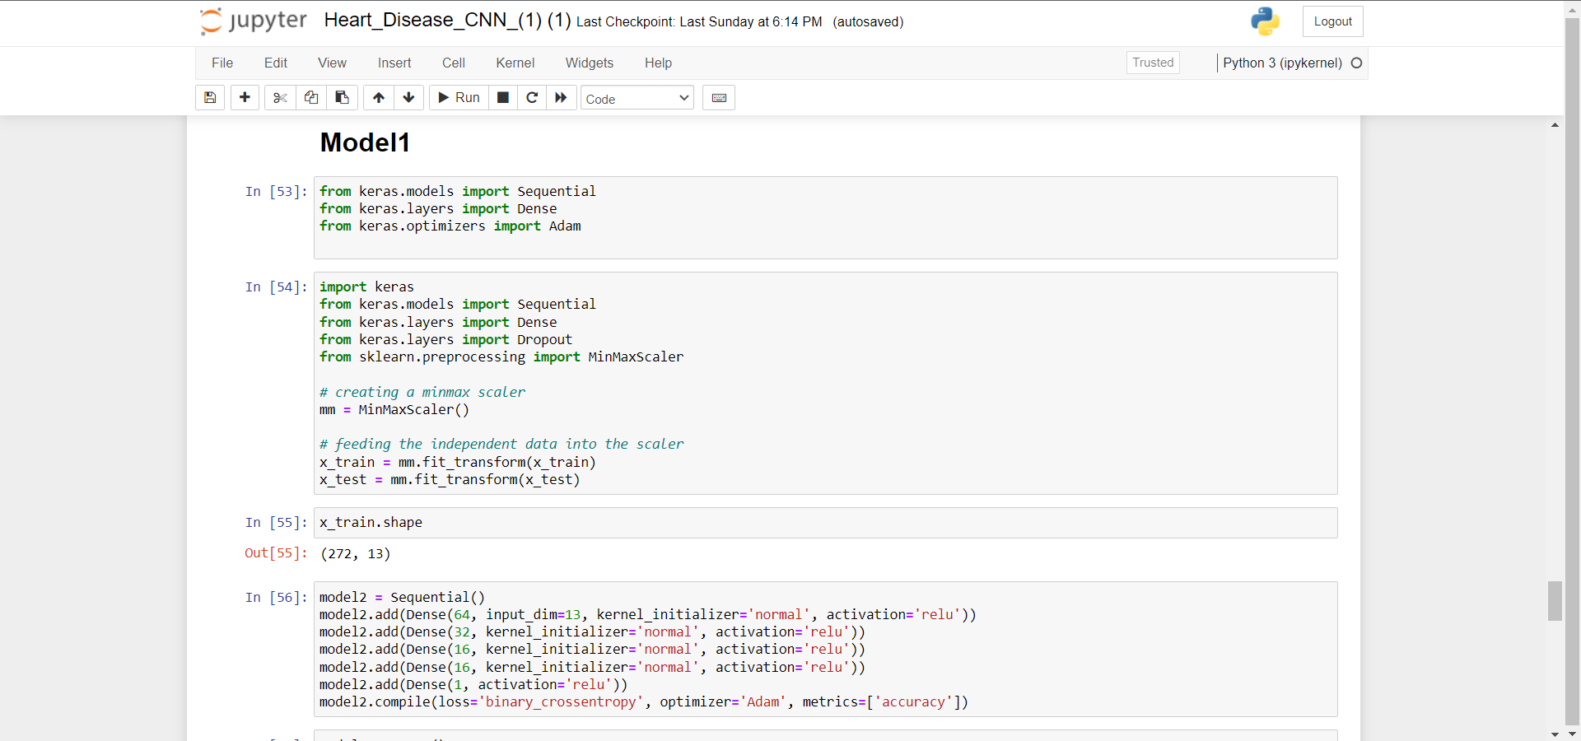
Heart Disease Prediction using Ai/ML

Slide 18
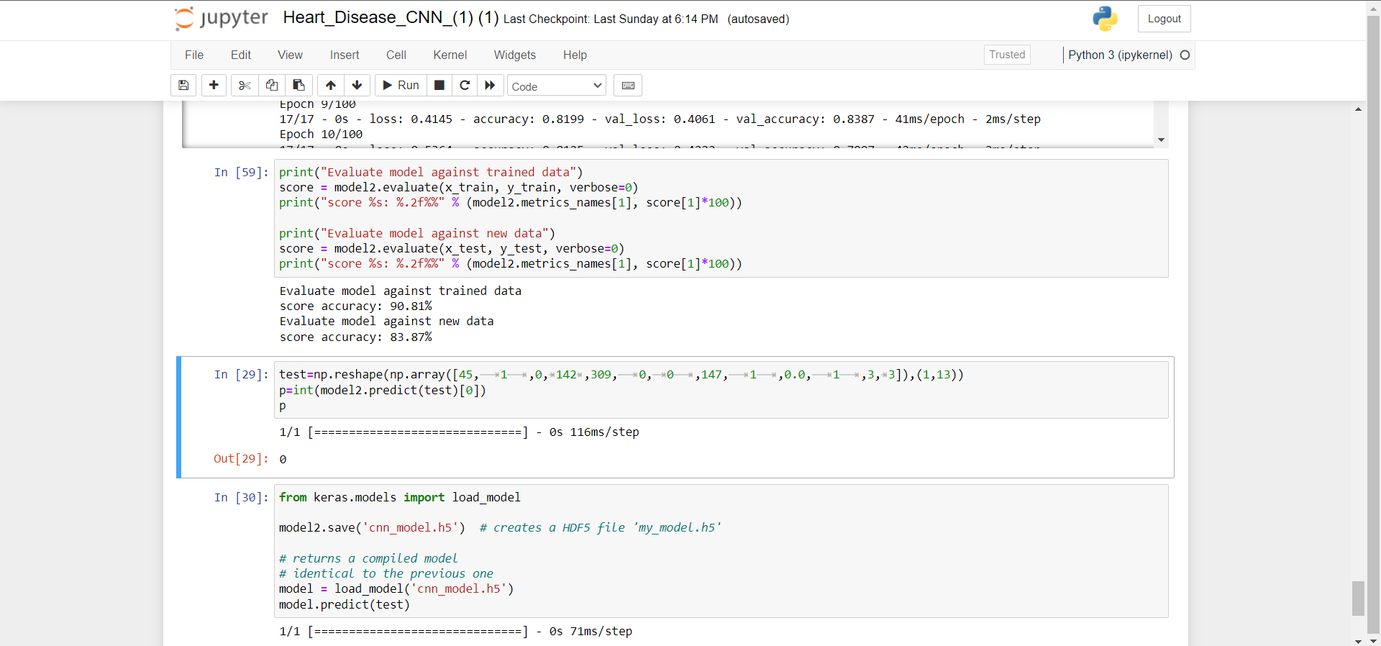
Heart Disease Prediction using Ai/ML

Slide 19
Thank You!! Batch No: 23
Heart Disease Prediction using Ai/ML
Department of ECE

